Slide 1

“Human-like problem-solving abilities in large language models using GPT-4”
Presented by:
Bahador Mirzazadeh
Amirhosein Kalhor
Alireza Saberi
Sadaf Jamali

Slide 2

Introduction
The objective of this research was to examine the problem-solving competencies of GPT-4. This was achieved by utilizing two distinct groups of verbal insight problems, benchmarked against a performance standard determined by a representative selection of human respondents.

Slide 3

Introduction
Verbal insight problem-solving
Analytical
Creative
Intuitive

Slide 4

Influential theories
“General Problem Solver” (GPS) hypothesis of Newell and Simon (1972)
“Dual-Process Hypothesis” (DPT), proposed by Kahneman (2011)
“Insight” by Wallas (1926)

Slide 5

DataSet
Practice Questions
Transfer Questions

Slide 6
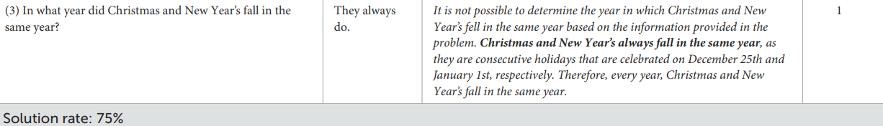
Problem solving task

Slide 7
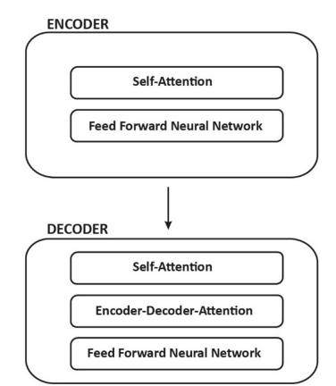
mODEL
Transformer

Slide 8
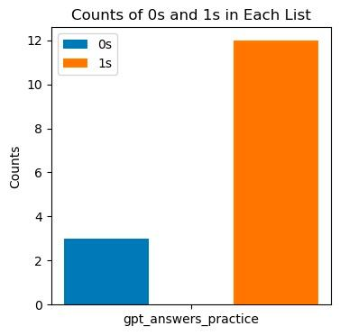
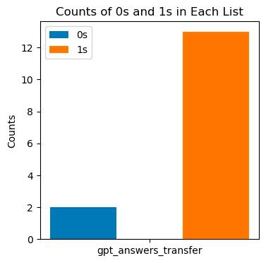
Results
Figure 1: Bar plot of Llama answers both practice and transfer questions
Notes:
Consider talking about:
Development
Pre-production
Filming

Slide 9
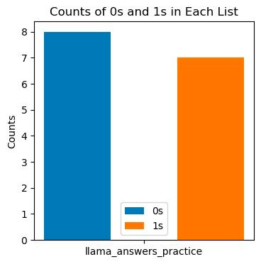
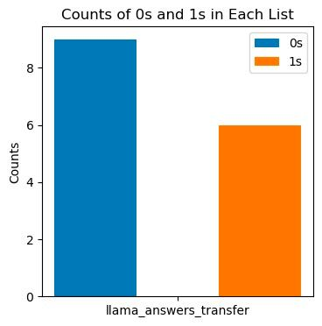
Results
Figure 2: Bar plot of GPT-4 answers both practice and transfer questions
Notes:
Consider talking about:
Development
Pre-production
Filming

Slide 10
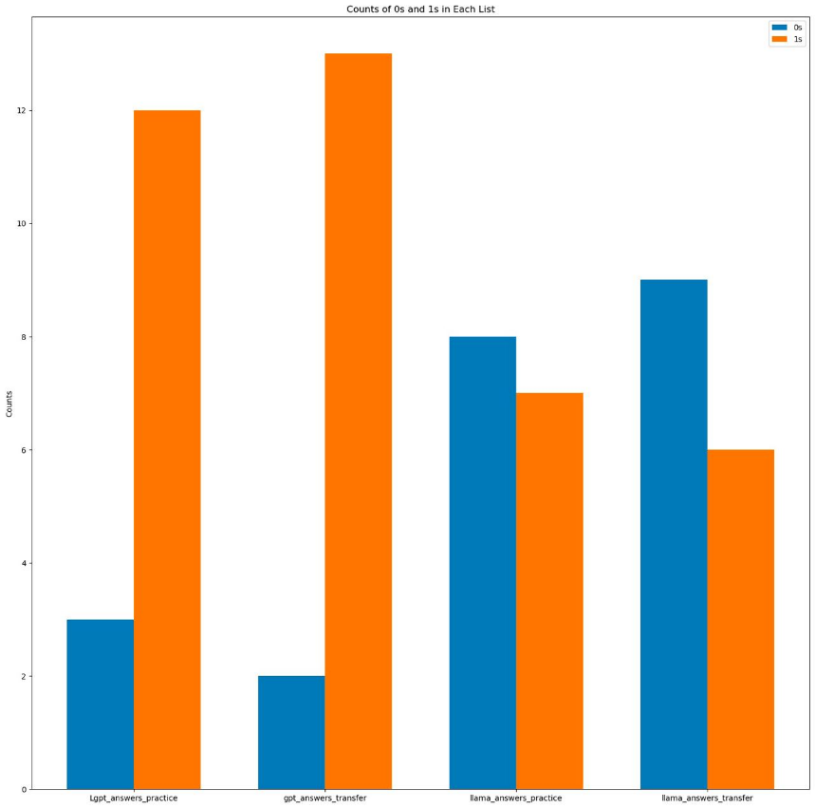
Results
Figure 3: Comparison of bar plot of GPT-4 and Llama answers to both practice and transfer questions
Notes:
Consider talking about:
Development
Pre-production
Filming

Slide 11
reference
Doe, J. (2023). AI Research. Frontiers. https://www.frontiersin.org/articles/10.3389/frai.2023.1199350/full
OpenAI. (2023). ChatGPT: A language model by OpenAI (Version GPT-4). Retrieved from [https://chat.openai.com]
Meta. (2023). Llama2: A language model by Meta. Retrieved from [https://replicate.com/blog/run-llama-2-with-an-api?utm_source=project&utm_campaign=llama2ai]

Slide 12
Thanks for your attention!
Notes:
Consider talking about:
Marketing
Home media
Box office

